Slide 1
JavaFX UI Controls

Slide 2
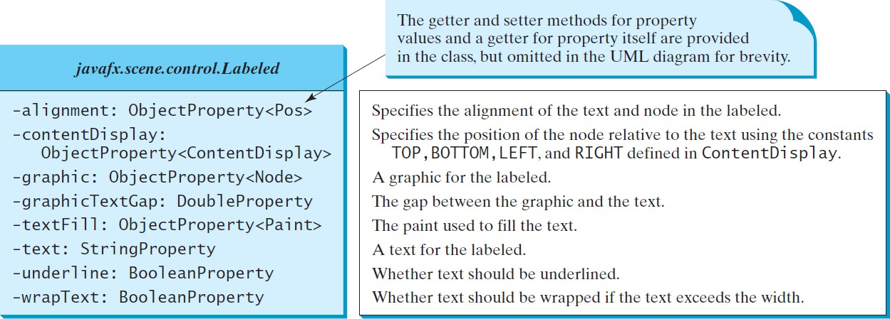
Labeled class
A label is a display area for a short text, a node, or both.
It is often used to label other controls (usually text fields).
Labels and buttons share many common properties: these common properties are defined in the Labeled class.
2

Slide 3
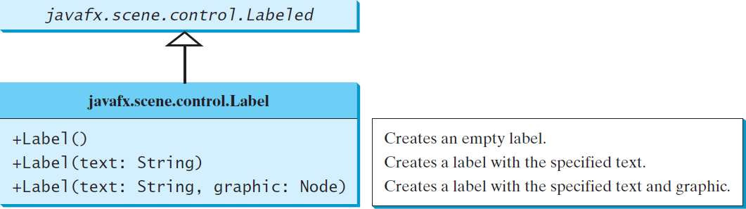
Label class
3

Slide 4
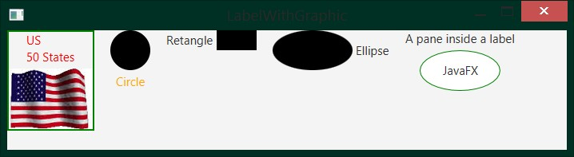
import javafx.application.Application; import javafx.stage.Stage;
import javafx.scene.Scene;
import javafx.scene.control.ContentDisplay;
import javafx.scene.control.Label; import javafx.scene.image.Image; import javafx.scene.image.ImageView; import javafx.scene.layout.HBox; import javafx.scene.layout.StackPane; import javafx.scene.paint.Color; import javafx.scene.shape.Circle; import javafx.scene.shape.Rectangle; import javafx.scene.shape.Ellipse;
public class LabelWithGraphic extends Application { @Override
public void start(Stage primaryStage) {
ImageView us = new ImageView(new Image("us.jpg"));
Label lb1 = new Label("US\n50 States", us);
lb1.setStyle("-fx-border-color: green; -fx-border-width: 2"); lb1.setContentDisplay(ContentDisplay.BOTTOM); lb1.setTextFill(Color.RED);
Label lb2 = new Label("Circle", new Circle(50, 50, 25)); lb2.setContentDisplay(ContentDisplay.TOP); lb2.setTextFill(Color.ORANGE);
Label lb3 = new Label("Retangle", new Rectangle(10, 10, 50, 25)); lb3.setContentDisplay(ContentDisplay.RIGHT);
Label lb4 = new Label("Ellipse", new Ellipse(50, 50, 50, 25)); lb4.setContentDisplay(ContentDisplay.LEFT);
4

Slide 5
Ellipse ellipse = new Ellipse(50, 50, 50, 25); ellipse.setStroke(Color.GREEN); ellipse.setFill(Color.WHITE);
StackPane stackPane = new StackPane(); stackPane.getChildren().addAll(ellipse, new Label("JavaFX")); Label lb5 = new Label("A pane inside a label", stackPane); lb5.setContentDisplay(ContentDisplay.BOTTOM);
HBox pane = new HBox(20); pane.getChildren().addAll(lb1, lb2, lb3, lb4, lb5);
Scene scene = new Scene(pane, 700, 150); primaryStage.setTitle("LabelWithGraphic"); primaryStage.setScene(scene); primaryStage.show();
}
public static void main(String[] args) { launch(args);
}
}
5

Slide 6
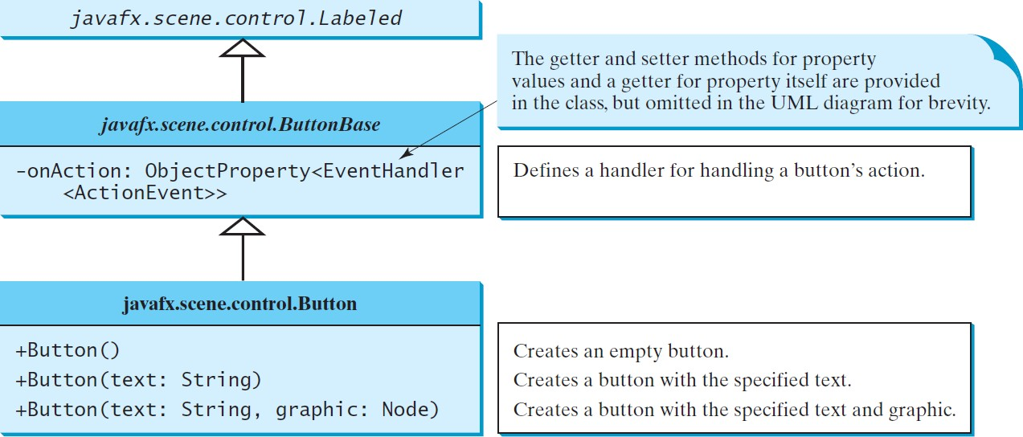
ButtonBase and Button
A button is a control that triggers an action event when clicked.
JavaFX provides regular buttons, toggle buttons, check box buttons, and radio buttons.
The common features of these buttons are defined in ButtonBase and Labeled classes.
6
(c) Paul Fodor and Pearson Inc.

Slide 7
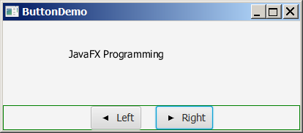
import javafx.application.Application; import javafx.stage.Stage;
import javafx.geometry.Pos; import javafx.scene.Scene;
import javafx.scene.control.Button; import javafx.scene.image.ImageView; import javafx.scene.layout.BorderPane; import javafx.scene.layout.HBox; import javafx.scene.layout.Pane; import javafx.scene.text.Text;
public class ButtonDemo extends Application { @Override
public void start(Stage primaryStage) {
Scene scene = new Scene(getPane(), 450, 200); primaryStage.setTitle("ButtonDemo"); primaryStage.setScene(scene); primaryStage.show();
}
protected Text text = new Text(50, 50, "JavaFX Programming"); protected BorderPane getPane() {
HBox paneForButtons = new HBox(20);
Button btLeft = new Button("Left", new ImageView("image/left.gif")); Button btRight = new Button("Right", new ImageView("image/right.gif")); paneForButtons.getChildren().addAll(btLeft, btRight); paneForButtons.setAlignment(Pos.CENTER);
paneForButtons.setStyle("-fx-border-color: green"); BorderPane pane = new BorderPane(); pane.setBottom(paneForButtons);
7

Slide 8
Pane paneForText = new Pane(); paneForText.getChildren().add(text); pane.setCenter(paneForText);
btLeft.setOnAction(e -> text.setX(text.getX() - 10)); btRight.setOnAction(e -> text.setX(text.getX() + 10));
return pane;
}
public static void main(String[] args) { launch(args);
}
}
8

Slide 9
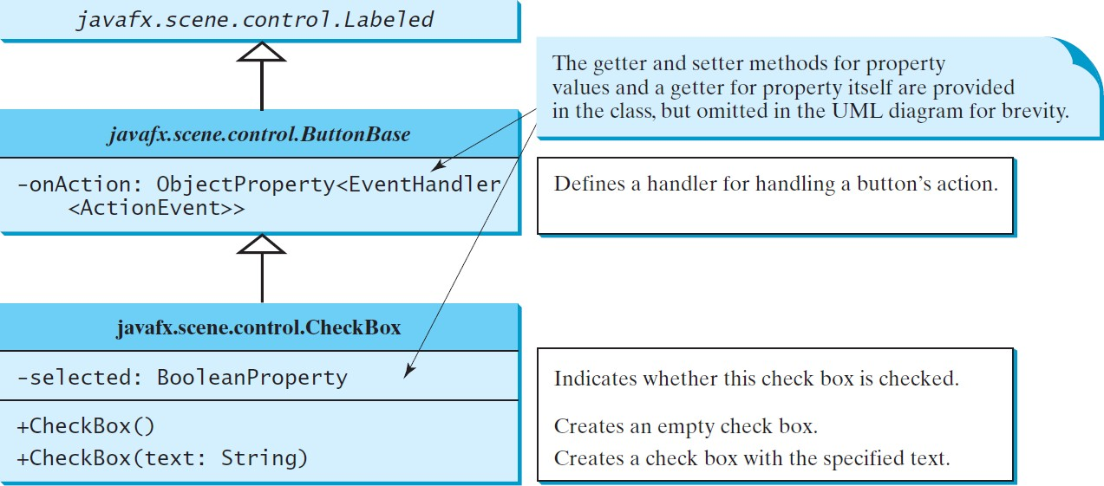
CheckBox
A CheckBox is used for the user to make a selection (square box).
CheckBox inherits all the properties from ButtonBase and Labeled: onAction, text, graphic, alignment, graphicTextGap, textFill, contentDisplay.
9
(c) Paul Fodor and Pearson Inc.

Slide 10
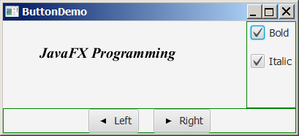
import javafx.event.ActionEvent; import javafx.event.EventHandler; import javafx.geometry.Insets; import javafx.scene.control.CheckBox;
import javafx.scene.layout.BorderPane; import javafx.scene.layout.VBox; import javafx.scene.text.Font;
import javafx.scene.text.FontPosture; import javafx.scene.text.FontWeight;
public class CheckBoxDemo extends ButtonDemo {
@Override // Override the getPane() method in the super class protected BorderPane getPane() {
BorderPane pane = super.getPane();
Font fontBoldItalic = Font.font("Times New Roman", FontWeight.BOLD, FontPosture.ITALIC, 20);
Font fontBold = Font.font("Times New Roman",
FontWeight.BOLD, FontPosture.REGULAR, 20); Font fontItalic = Font.font("Times New Roman",
FontWeight.NORMAL, FontPosture.ITALIC, 20); Font fontNormal = Font.font("Times New Roman",
FontWeight.NORMAL, FontPosture.REGULAR, 20);
text.setFont(fontNormal);
VBox paneForCheckBoxes = new VBox(20); paneForCheckBoxes.setPadding(new Insets(5, 5, 5, 5)); paneForCheckBoxes.setStyle("-fx-border-color: green");

Slide 11
CheckBox chkBold = new CheckBox("Bold"); CheckBox chkItalic = new CheckBox("Italic");
paneForCheckBoxes.getChildren().addAll(chkBold, chkItalic); pane.setRight(paneForCheckBoxes);
EventHandler<ActionEvent> handler = e -> {
if (chkBold.isSelected() && chkItalic.isSelected()) { text.setFont(fontBoldItalic); // Both check boxes checked
} else if (chkBold.isSelected()) { text.setFont(fontBold); // The Bold check box checked
} else if (chkItalic.isSelected()) { text.setFont(fontItalic); // The Italic check box checked
} else {
text.setFont(fontNormal); // Both check boxes unchecked
}
};
chkBold.setOnAction(handler);
chkItalic.setOnAction(handler);
return pane; // Return a new pane
}
// the start method is inherited from the superclass ButtonDemo public static void main(String[] args) {
launch(args);
}
}

Slide 12
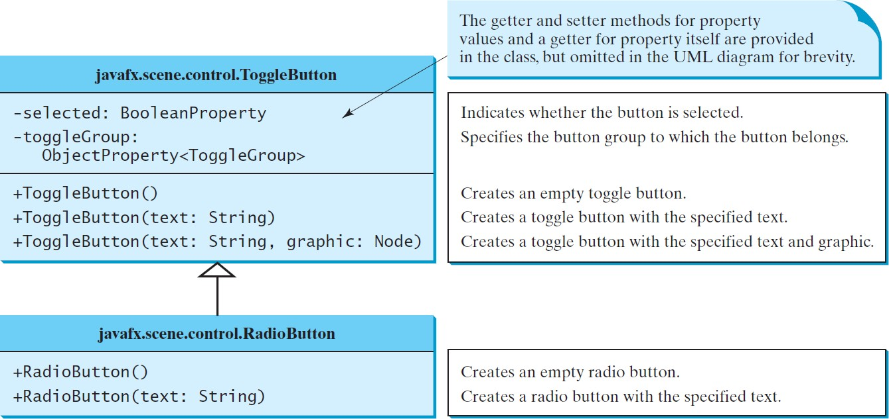
RadioButton
Radio buttons allow to choose a single item from a group of choices.
Radio buttons display a circle that is either filled (if selected) or blank (if not selected).

Slide 13
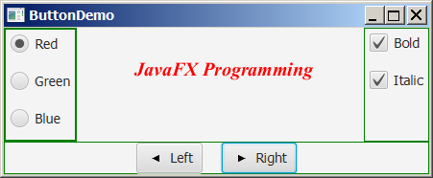
import static javafx.application.Application.launch; import javafx.geometry.Insets;
import javafx.scene.control.RadioButton; import javafx.scene.control.ToggleGroup; import javafx.scene.layout.BorderPane; import javafx.scene.layout.VBox;
import javafx.scene.paint.Color;
public class RadioButtonDemo extends CheckBoxDemo {
@Override // Override the getPane() method in the super class protected BorderPane getPane() {
BorderPane pane = super.getPane();
VBox paneForRadioButtons = new VBox(20); paneForRadioButtons.setPadding(new Insets(5, 5, 5, 5)); paneForRadioButtons.setStyle("-fx-border-color: green"); RadioButton rbRed = new RadioButton("Red");
RadioButton rbGreen = new RadioButton("Green");
RadioButton rbBlue = new RadioButton("Blue"); paneForRadioButtons.getChildren().addAll(rbRed, rbGreen, rbBlue); pane.setLeft(paneForRadioButtons);
ToggleGroup group = new ToggleGroup(); rbRed.setToggleGroup(group); rbGreen.setToggleGroup(group); rbBlue.setToggleGroup(group);
rbRed.setOnAction(e -> {
if (rbRed.isSelected()) { text.setFill(Color.RED);
}
});
13

Slide 14
rbGreen.setOnAction(e -> {
if (rbGreen.isSelected()) { text.setFill(Color.GREEN);
}
});
rbBlue.setOnAction(e -> {
if (rbBlue.isSelected()) { text.setFill(Color.BLUE);
}
});
return pane;
}
// the start method is inherited from the superclass ButtonDemo public static void main(String[] args) {
launch(args);
}
}
14

Slide 15
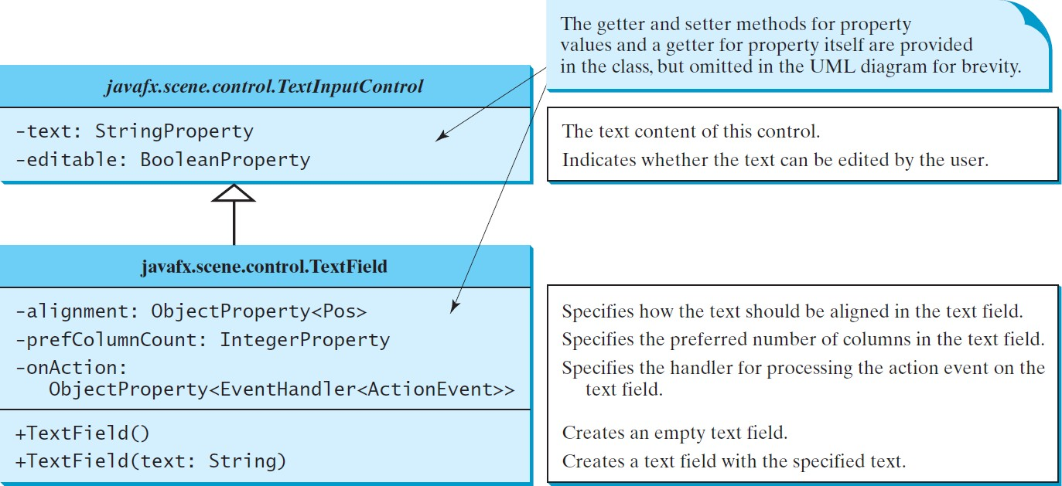
TextField
A text field can be used to enter or display a string.TextField is a subclass of TextInputControl.
15

Slide 16
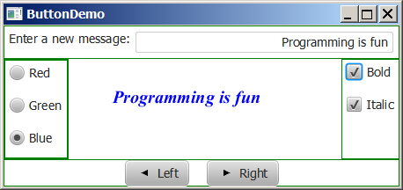
import static javafx.application.Application.launch; import javafx.geometry.Insets;
import javafx.geometry.Pos; import javafx.scene.control.Label;
import javafx.scene.control.TextField;
import javafx.scene.layout.BorderPane;
public class TextFieldDemo extends RadioButtonDemo{ @Override
protected BorderPane getPane() { BorderPane pane = super.getPane();
BorderPane paneForTextField = new BorderPane(); paneForTextField.setPadding(new Insets(5, 5, 5, 5)); paneForTextField.setStyle("-fx-border-color: green"); paneForTextField.setLeft(new Label("Enter a new message: "));
TextField tf = new TextField(); tf.setAlignment(Pos.BOTTOM_RIGHT); paneForTextField.setCenter(tf); pane.setTop(paneForTextField);
tf.setOnAction(e -> text.setText(tf.getText())); return pane;
}
public static void main(String[] args) { launch(args);
}
}16

Slide 17
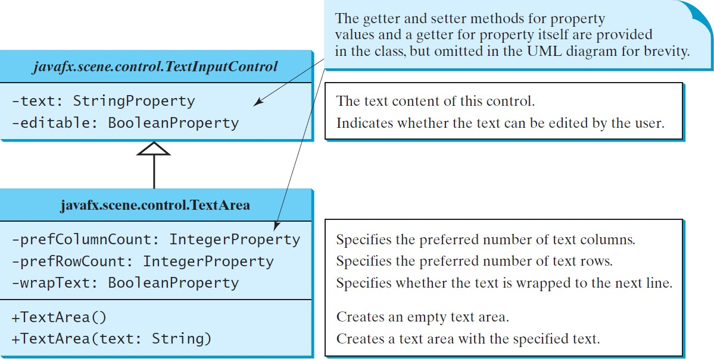
TextArea
A TextArea enables the user to enter multiple lines of text.
17

Slide 18
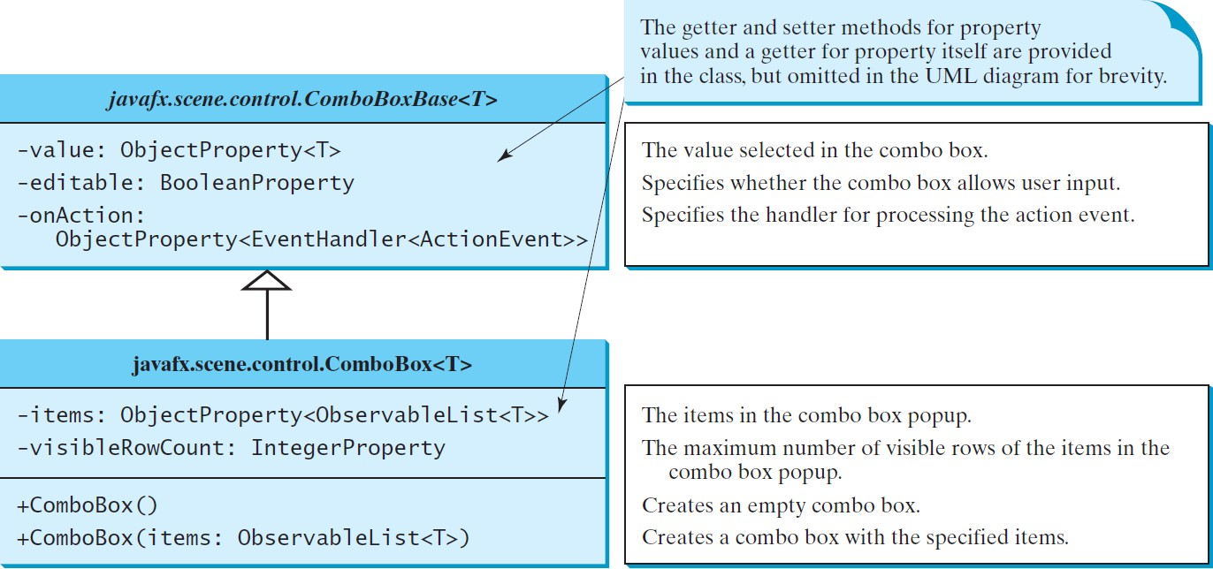
ComboBox
A combo box, also known as a choice list or drop-down list, contains a list of items from which the user can choose.
18

Slide 19
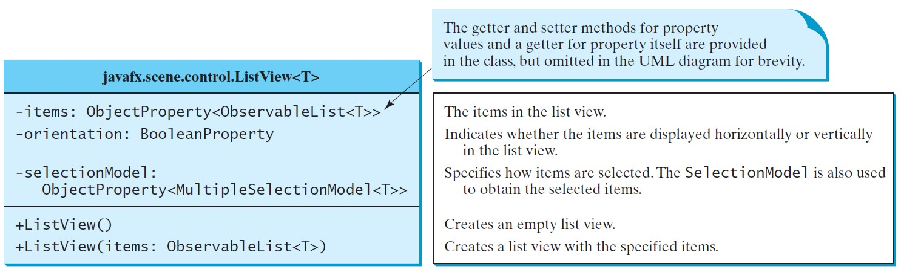
ListView
A list view is a component that performs basically the same function as a combo box, but it enables the user to choose a single value or multiple values.
19

Slide 20
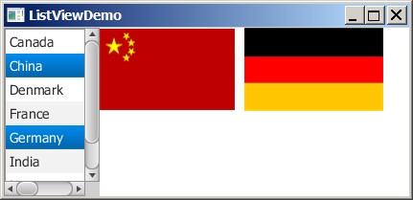
import javafx.application.Application; import javafx.stage.Stage;
import javafx.scene.Scene;
import javafx.scene.control.ListView; import javafx.scene.control.ScrollPane; import javafx.scene.control.SelectionMode; import javafx.scene.image.ImageView; import javafx.scene.layout.BorderPane; import javafx.scene.layout.FlowPane; import javafx.collections.FXCollections;
public class ListViewDemo extends Application {
// Declare an array of Strings for flag titles
private String[] flagTitles = {"United States of America", "Canada", "China", "Denmark", "France", "Germany", "India"};
// Declare an ImageView array for the national flags private ImageView[] ImageViews = {
new ImageView("image/us.gif"), new ImageView("image/ca.gif"), new ImageView("image/china.gif"),
new ImageView("image/denmark.gif"), new ImageView("image/fr.gif"),
new ImageView("image/germany.gif"), new ImageView("image/india.gif")
};
@Override
public void start(Stage primaryStage) { ListView<String> lv = new ListView<>(FXCollections
.observableArrayList(flagTitles));
20
lv.setPrefSize(400, 400);

Slide 21
lv.getSelectionModel().setSelectionMode(SelectionMode.MULTIPLE);
// Create a pane to hold image views FlowPane imagePane = new FlowPane(10, 10); BorderPane pane = new BorderPane(); pane.setLeft(new ScrollPane(lv)); pane.setCenter(imagePane);
lv.getSelectionModel().selectedItemProperty().addListener( ov -> {
imagePane.getChildren().clear();
for (Integer i: lv.getSelectionModel().getSelectedIndices()) { imagePane.getChildren().add(ImageViews[i]);
}
});
Scene scene = new Scene(pane, 450, 170); primaryStage.setTitle("ListViewDemo"); primaryStage.setScene(scene); primaryStage.show();
}
public static void main(String[] args) { launch(args);
}
}

Slide 22
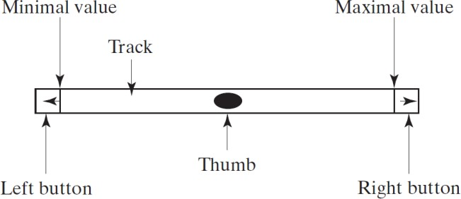
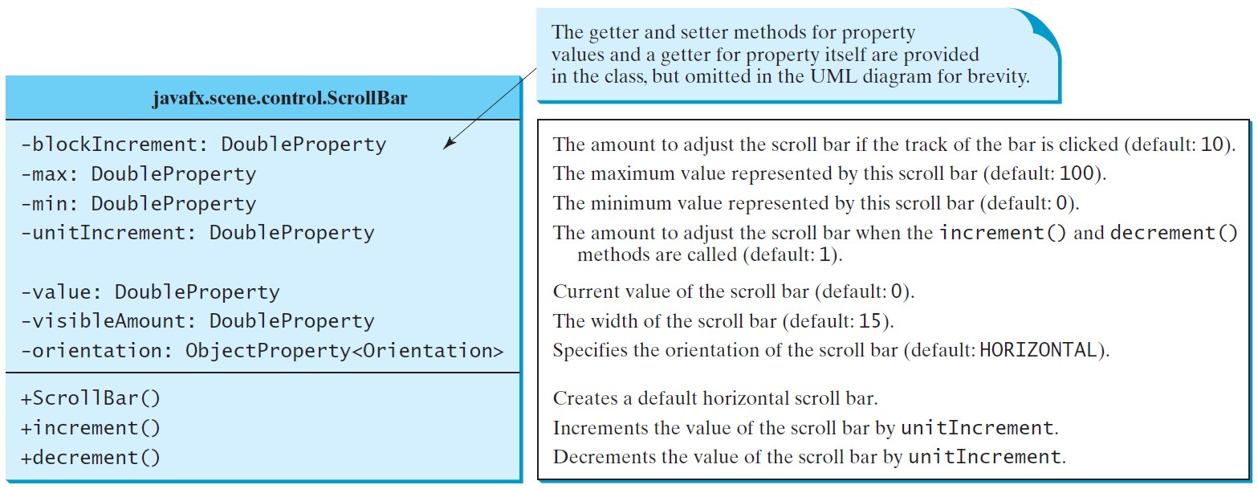
ScrollBar
A scroll bar is a control that enables the user to select from a range of values.The scrollbar appears in two styles: horizontal and vertical.

Slide 23
Menus
Menus make selection easier and are widely used in window applications.
JavaFX provides five classes that implement menus: MenuBar, Menu, MenuItem, CheckMenuItem, and RadioButtonMenuItem.
MenuBar is a top-level menu component used to hold the menus.
A menu consists of menu items that the user can select (or toggle on or off).
A menu item can be an instance of MenuItem, CheckMenuItem, or RadioButtonMenuItem.
Menu items can be associated with nodes and keyboard
37
accelerators.
(c) Paul Fodor and Pearson Inc.

Slide 24
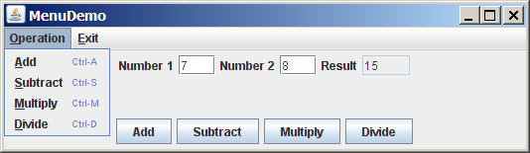
import javafx.application.Application; import javafx.stage.Stage;
import javafx.scene.Scene;
import javafx.scene.control.Button; import javafx.scene.control.Label; import javafx.scene.control.Menu; import javafx.scene.control.MenuBar; import javafx.scene.control.MenuItem; import javafx.scene.control.TextField;
import javafx.scene.input.KeyCombination; import javafx.scene.layout.HBox;
import javafx.scene.layout.VBox; import javafx.geometry.Pos;
public class MenuDemo extends Application { private TextField tfNumber1 = new TextField(); private TextField tfNumber2 = new TextField(); private TextField tfResult = new TextField();
38

Slide 25
@Override
public void start(Stage primaryStage) { MenuBar menuBar = new MenuBar();
Menu menuOperation = new Menu("Operation"); Menu menuExit = new Menu("Exit");
menuBar.getMenus().addAll(menuOperation, menuExit);
MenuItem menuItemAdd = new MenuItem("Add");
MenuItem menuItemSubtract = new MenuItem("Subtract"); MenuItem menuItemMultiply = new MenuItem("Multiply"); MenuItem menuItemDivide = new MenuItem("Divide");
menuOperation.getItems().addAll(menuItemAdd, menuItemSubtract, menuItemMultiply, menuItemDivide);
MenuItem menuItemClose = new MenuItem("Close"); menuExit.getItems().add(menuItemClose);
menuItemAdd.setAccelerator( KeyCombination.keyCombination("Ctrl+A"));
menuItemSubtract.setAccelerator(
KeyCombination.keyCombination("Ctrl+S"));
menuItemMultiply.setAccelerator( KeyCombination.keyCombination("Ctrl+M"));
menuItemDivide.setAccelerator( KeyCombination.keyCombination("Ctrl+D"));
HBox hBox1 = new HBox(5); tfNumber1.setPrefColumnCount(2); tfNumber2.setPrefColumnCount(2); tfResult.setPrefColumnCount(2);
39

Slide 26
hBox1.getChildren().addAll(new Label("Number 1:"), tfNumber1, new Label("Number 2:"), tfNumber2, new Label("Result:"), tfResult);
hBox1.setAlignment(Pos.CENTER);
HBox hBox2 = new HBox(5);
Button btAdd = new Button("Add");
Button btSubtract = new Button("Subtract"); Button btMultiply = new Button("Multiply"); Button btDivide = new Button("Divide");
hBox2.getChildren().addAll(btAdd, btSubtract, btMultiply, btDivide); hBox2.setAlignment(Pos.CENTER);
VBox vBox = new VBox(10); vBox.getChildren().addAll(menuBar, hBox1, hBox2); Scene scene = new Scene(vBox, 300, 250);
primaryStage.setTitle("MenuDemo"); // Set the window title primaryStage.setScene(scene); // Place the scene in the window primaryStage.show(); // Display the window
// Handle menu actions menuItemAdd.setOnAction(e -> perform('+')); menuItemSubtract.setOnAction(e -> perform('-')); menuItemMultiply.setOnAction(e -> perform('*')); menuItemDivide.setOnAction(e -> perform('/')); menuItemClose.setOnAction(e -> System.exit(0));
// Handle button actions btAdd.setOnAction(e -> perform('+')); btSubtract.setOnAction(e -> perform('-')); btMultiply.setOnAction(e -> perform('*')); btDivide.setOnAction(e -> perform('/'));
(c) Paul Fodor and Pearson Inc.
40
}

Slide 27
private void perform(char operator) {
double number1 = Double.parseDouble(tfNumber1.getText()); double number2 = Double.parseDouble(tfNumber2.getText());
double result = 0; switch (operator) {
case | '+': | result | = | number1 | + | number2; | break;
case | '-': | result | = | number1 | - | number2; | break;
case | '*': | result | = | number1 | * | number2; | break;
case | '/': | result | = | number1 | / | number2; | break;
}
tfResult.setText(result + "");
};
public static void main(String[] args) { launch(args);
}
}
27

Slide 28
Context Menu
A context menu (also known as a popup menu) is like a regular menu, but does not have a menu bar and can float anywhere on the screen.
Creating a context menu is similar to creating a regular menu.
First, create an instance of ContextMenu, then add MenuItem, CheckMenuItem, and RadioMenuItem to the context menu.
28

Slide 29
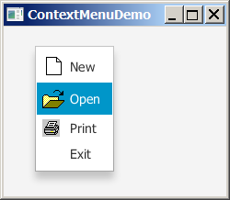
import javafx.application.Application; import javafx.stage.Stage;
import javafx.scene.Scene; import javafx.scene.layout.Pane;
import javafx.scene.control.ContextMenu; import javafx.scene.control.MenuItem; import javafx.scene.image.ImageView;
public class ContextMenuDemo extends Application { @Override
public void start(Stage primaryStage) { ContextMenu contextMenu = new ContextMenu(); MenuItem menuItemNew = new MenuItem("New",
new ImageView("image/new.gif"));
MenuItem menuItemOpen = new MenuItem("Open", new ImageView("image/open.gif"));
MenuItem menuItemPrint = new MenuItem("Print", new ImageView("image/print.gif"));
MenuItem menuItemExit = new MenuItem("Exit"); contextMenu.getItems().addAll(menuItemNew, menuItemOpen,
menuItemPrint, menuItemExit); Pane pane = new Pane();
Scene scene = new Scene(pane, 300, 250); primaryStage.setTitle("ContextMenuDemo"); primaryStage.setScene(scene); primaryStage.show();
29

